Slide 1
“The Heart of Harkness” Is Inquiry

Slide 2
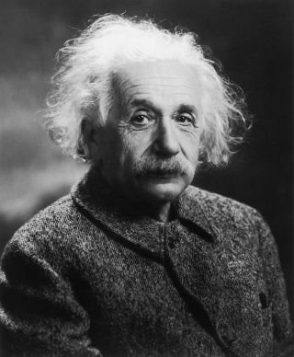
“If I had an hour to solve a problem and my life depended on the solution, I would spend the first 55 minutes determining the proper question to ask… for once I know the proper question, I could solve the problem in less than five minutes.”
- Albert Einstein

Slide 3
TO ENCOURAGE A CULTURE OF INQUIRY, ASK THESE 4 QUESTIONS:
How can we make it safe to question?
How can we make questioning
rewarding?
How might we make questioning
productive?
How can we make a culture of inquiry
stick?

Slide 4
We Need to Teach the Art of Asking Good Questions!
LEVEL 1 Summarizing/Definition/Fact questions
What is the definition of …?
Who did … ?
When did … occur?
How much/many … ?
What is an example of … ?

Slide 5
Level 2: Analysis/Interpretation Questions
How did…. occur?
Why does … occur?
What are the reasons for … ?
What are types of … ?
How does … function?
How does the process occur?
What are my own examples of… ?
What causes … to occur?
What results when … occurs?
What is the relationship between … & … ?
How is … similar to/different from… ?
How does … effect or apply to … ?
What does … mean?
What conclusions can be drawn from … info?
What is (are) the problem(s), conflict(s), or issue(s)?
What are possible solutions/resolutions to these problem(s), conflict(s), or issue(s)?
What is the main argument or thesis?
How is this argument developed?
What evidence, proof, support is offered?
What are other theories, arguments from other authors?

Slide 6
Level 3: Hypothesis/Prediction Questions
If … occurs, then what would happen?
If … changed, then what would change?
What does theory X predict will happen?
What hypothesis or theory explains this data or given information?

Slide 7
Level 4: Critical Analysis/Evaluation/Opinion Questions
Is … good/bad? … correct/incorrect? … effective/ineffective? … relevant/irrelevant? … logical/illogical? … applicable/not applicable? … proven/not proven? … ethical/not ethical? WHY?
What are the advantages or disadvantages of …? WHY?
What is the best solution to the problem, conflict or issue? Why is it the best?
What should or should not happen? WHY?
Do I agree or disagree? WHY?
What is my opinion? What is my support for my opinion?

Slide 8
Students Practice Creating Questions at Each Level
Level I questions:
How does the school define plagiarism?
Level II Questions
What might happen to the teacher if he or she gave this project a good grade?
Level III Questions
Would the fact that the girl got caught cheating severely affect her future and who she becomes in life?
Level IV Questions
Does being ill or hurt give people a pass in life to be able to achieve their goals through pity rather than
quality work?

Slide 9
Using These Questions to Begin Discussion at the Table
Level l:
Where is Budapest?
When did this story occur?
What is the definition of “Mother of Bones”
in this specific story?
Level ll:
What are some of the causes of children thinking
America is a place to “ work in nursing homes and
clean poop,”?
What are the long term results when poor children
have built up anger against the upper class?
What is the relationship between the woman and the children?
Level lll:
What would have happened if the woman hadn’t thrown her food away and the conflict between the upper class and lower class hadn’t arisen?
If the kids hadn't seen the woman hanging from a tree in Budapest, would they have different opinions involving how events like this can happen to the wealthy?
What theory about poverty and social inequities supports the story? Why?
Level lV:
Is stealing from a dead person to profit yourself ethical? Why or why not?
Does the difference in social class contribute to negative thoughts that negatively envelope a society?
What is the best solution to feelings of social indifference and poverty in society? Why is this the best solution? Do you think this solution could be applied to our modern society today?

Slide 10
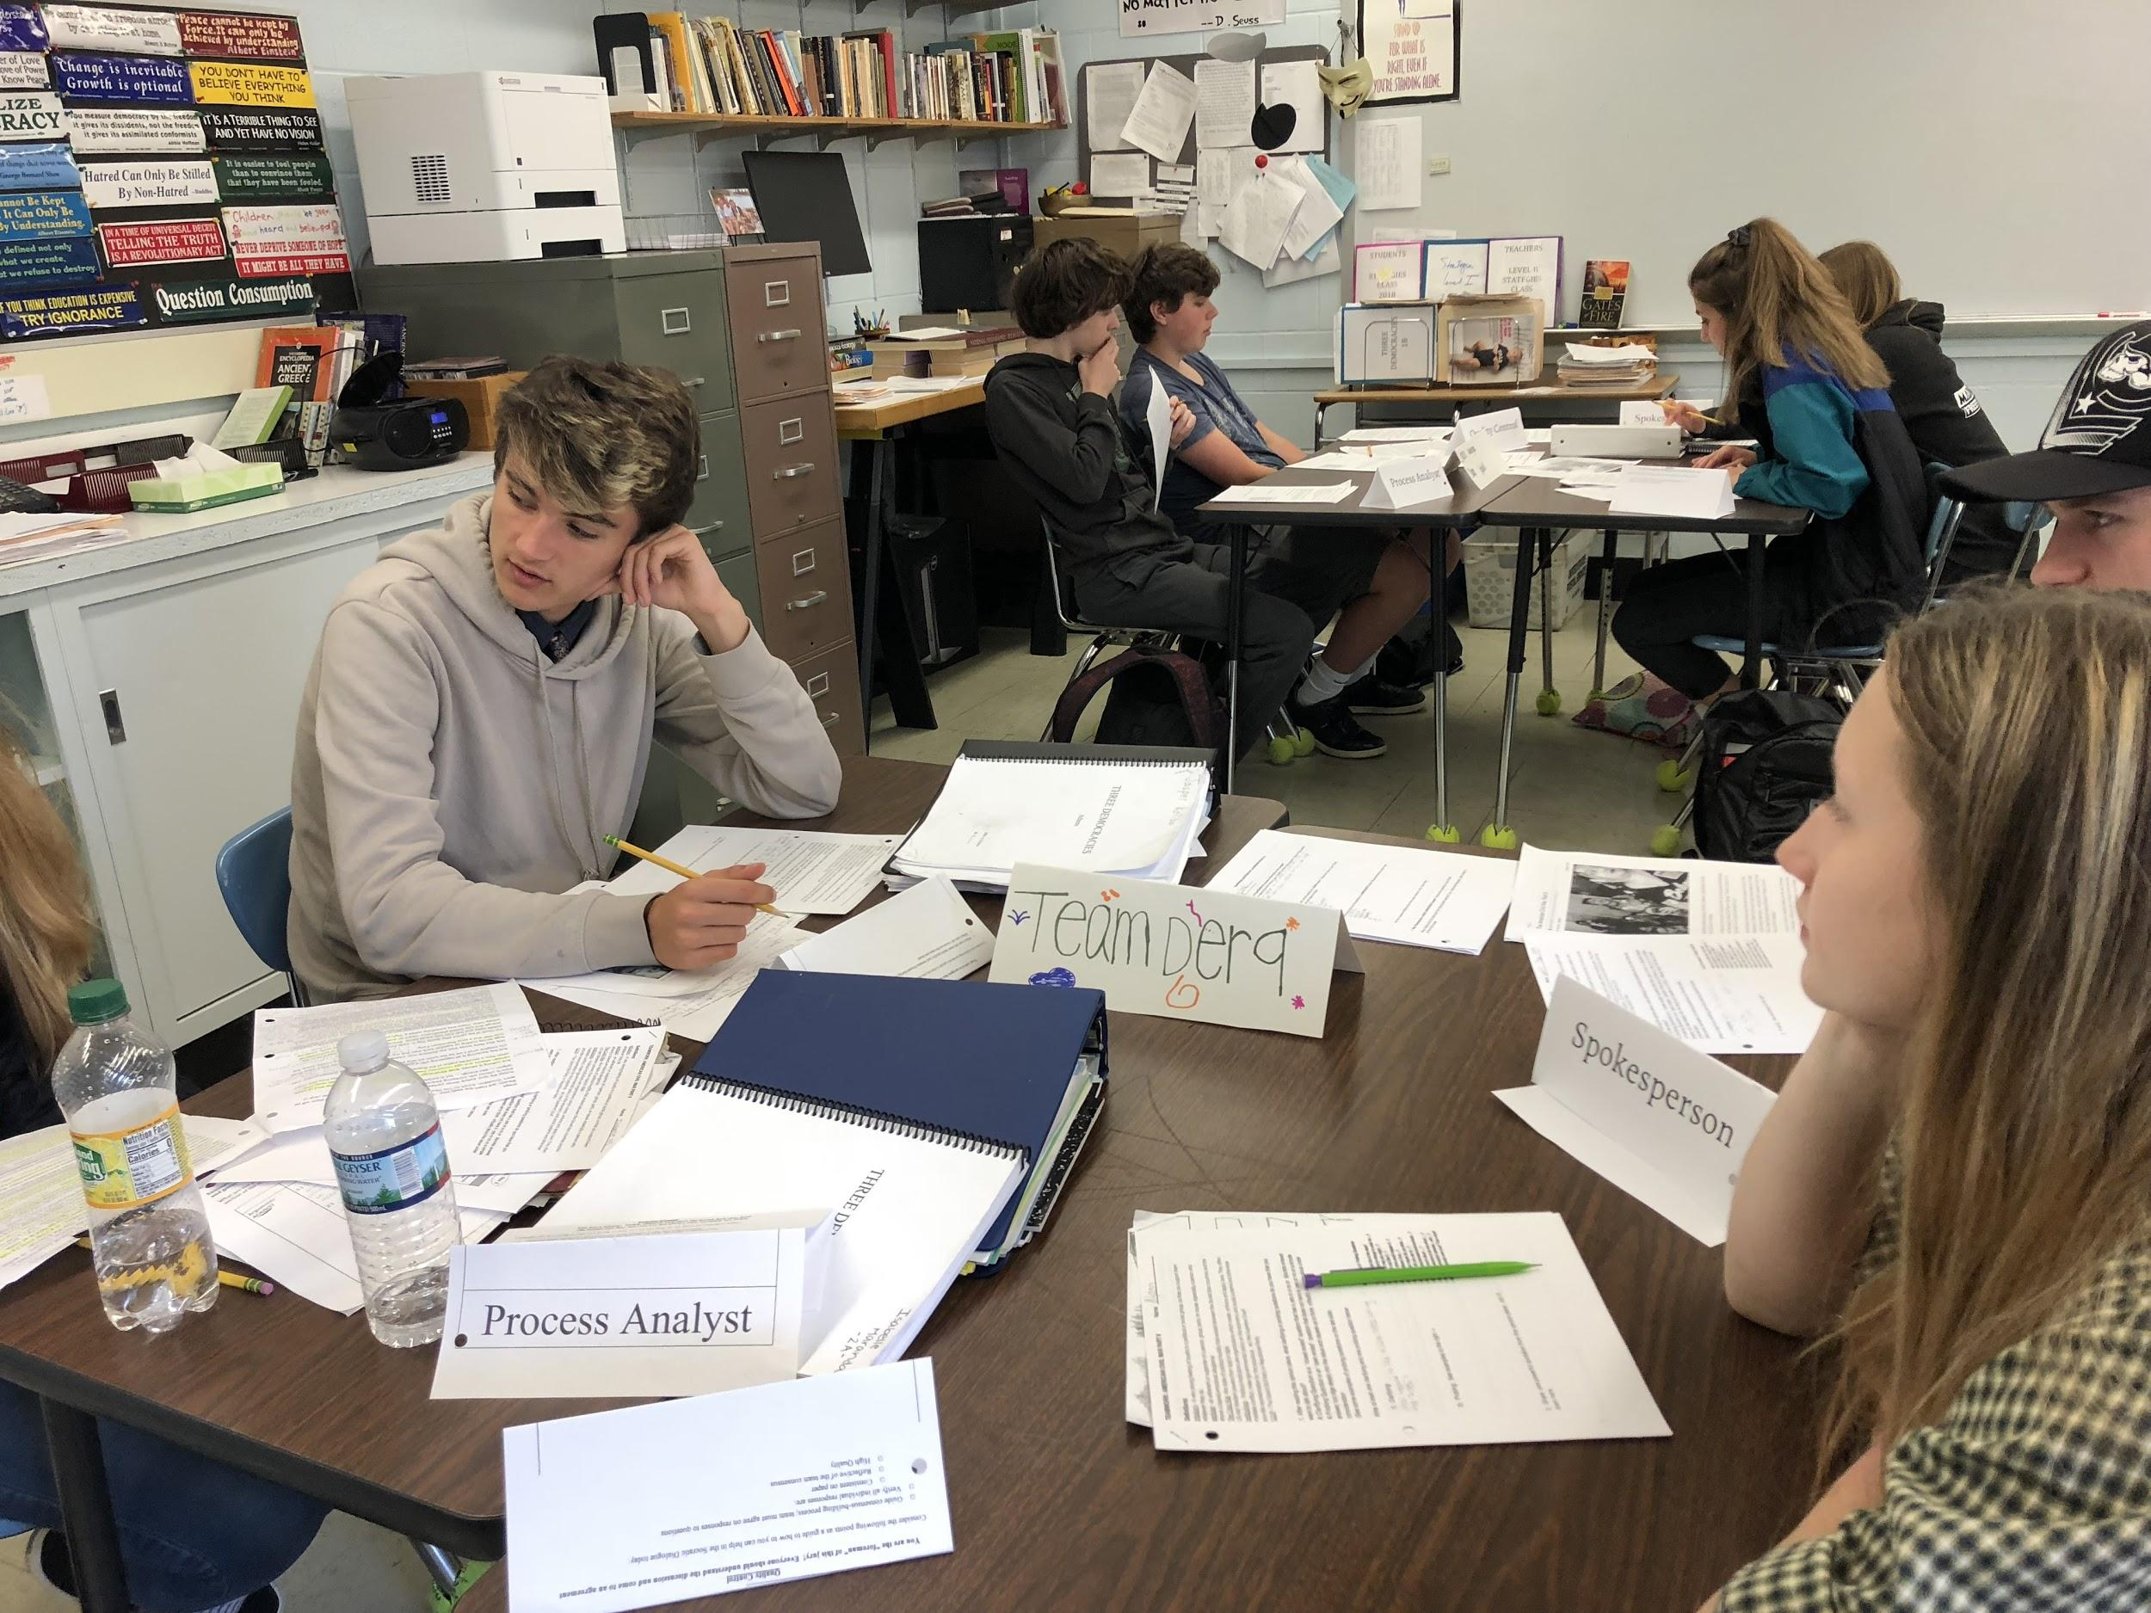
Using Questions in TEAMWORK
As preparation for Harkness at the Table

Slide 11
TEAMWORK Questions on Federalist #51
in Preparation for Harkness
Explain how checks and balances are different from separation of powers.
Describe Madison’s argument for the necessity of separating power between the branches of government.
How is government a reflection on human nature? (Refer to the famous passage on page 80)
Explain why Madison believes the legislature might need to be weakened, and describe his proposed remedy for weakening the legislature.
How would a larger federal system aid the process of self-government?

